Slide 1

Course: BSc CSIT Madan Bhandari Memorial College Geographic Information System
Introduction
CSC482 Unit-1 Class 1
Dfw' ;'bg clwsf/L

Slide 2
Agenda
Definition of GIS
GIS in daily life and spatial thinking
Components of a GIS (hardware, software, data, people, methods)
Functional subsystems of a GIS (input, storage, analysis, output)
Classroom activities and reflection
Summary and quiz questions

Slide 3
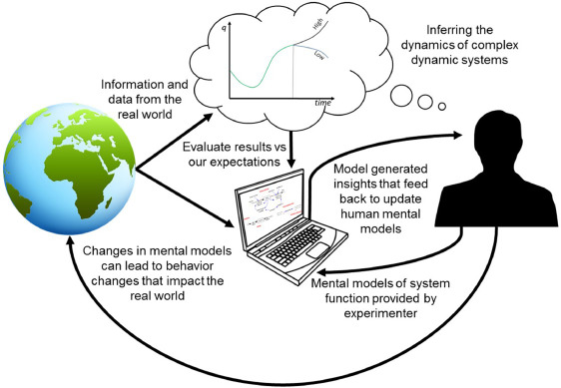
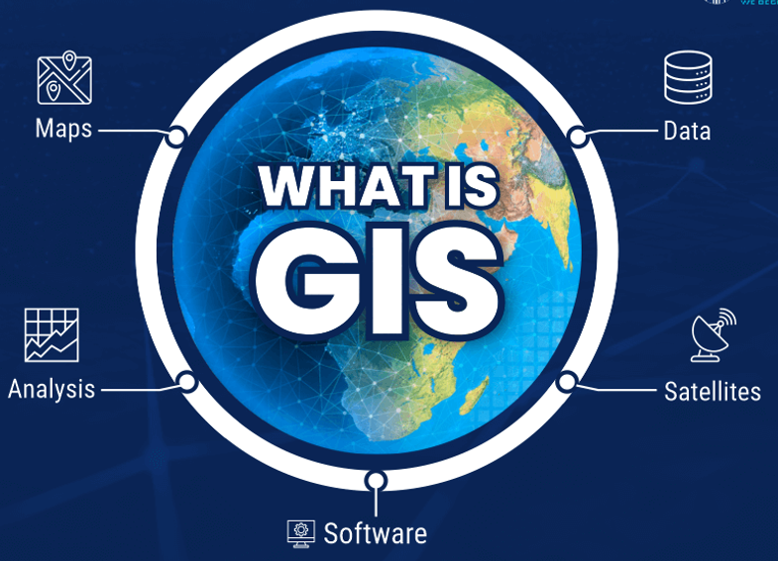
What is GIS? – Part 1
GIS = Geographic Information System, a computer-based tool for mapping and analyzing features on Earth
It integrates database operations (like queries and statistics) with geographical visualization (maps)

Slide 4
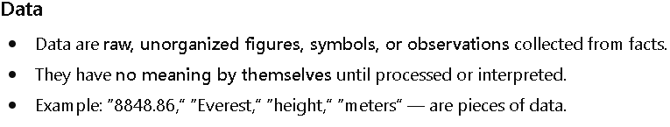
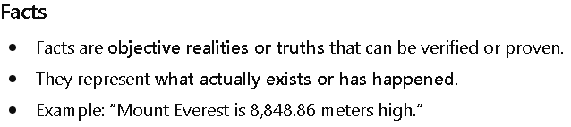
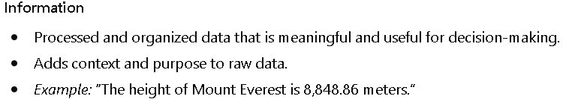
What is GIS? – Part 1…
Facts (real world phenomena) are the source of truth from which data are collected
Data are raw inputs derived from facts
When data are processed, analyzed, and contextualized, they become information
Facts → Data → Processing → Information

Slide 5
What is GIS? – Part 1…
A process is a series of systematic operations to convert input (raw data) into output (information)
System
Input
Processing
Output
Raw data entered into the system (e.g., survey results, sensor readings, text entries)
sorting, classifying, calculating, comparing, and summarizing
meaningful information (e.g., reports, charts, summaries)

Slide 6

What is GIS? – Part 2
GIS captures, stores, updates, manipulates and displays all forms of geographically referenced data
It is valuable for explaining events, predicting outcomes, and planning strategies based on location.
G
S
mechanism that allows us to capture, store, retrieve, query, analyze, and visualize data related to geographic locations

Slide 7
Input: spatial data
G
S
GIS/Mapping Software: analysis and data visualization
Does not come with its own data
Output: new data and maps

Slide 8
Why GIS Matters – Efficiency
It saves time and money by automating data analysis and map production
GIS performs mapping and analysis faster and better than manual methods

Slide 9
Why GIS Matters – Communication
GIS enables better decision-making by overlaying multiple data layers (e.g. population, roads, resources) on one map
Visual maps are easily understood by people from all backgrounds, improving communication

Slide 10
Why GIS Matters – Real Problems
GIS solves real-world problems: e.g. routing delivery trucks, planning utility networks, managing resources.
It provides a “geographic perspective” to issues like traffic congestion or emergency response.

Slide 11
Everyday Example
GPS apps (Google Maps, Apple Maps) use GIS to find and display routes.
These apps access GIS data to choose shortest paths and update your location in real time
Delivery apps (food, packages) and ride-hailing use GIS for optimal routing
They calculate the fastest route avoiding traffic (Nepal examples: Pathao, Tootle for motorcycles, food delivery apps)
Ride-sharing apps (e.g. Pathao, Jeevan Shah) show live driver/passenger locations on a map.
GIS matches nearest driver to rider and plans the route.
It also calculates fares and Electronic System for Travel Authorization (ESTA)

Slide 12

Spatial Thinking
Spatial thinking = understanding location, distance, and spatial relationships (north/south, near/far).
We use it when choosing shortest routes, comparing neighborhoods, or picturing data on a map.

Slide 13
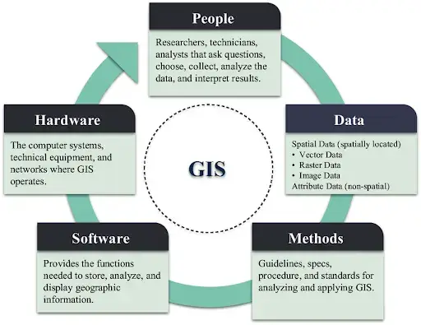
Components
GIS is more than software: it has 5 key components

Slide 14
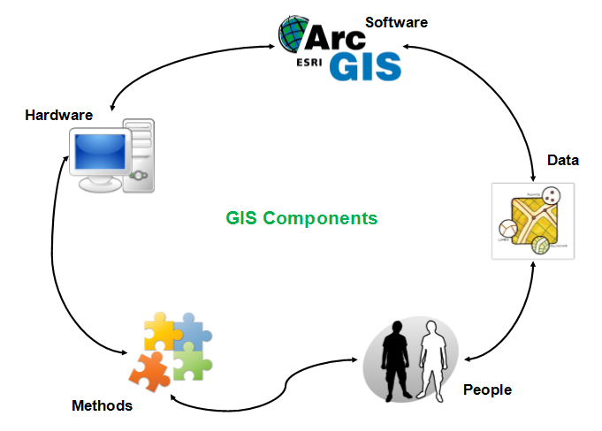
Components of GIS – Overview
The five fundamental components are:
Hardware (computers, GPS, scanners, Plotters)
Software (GIS applications like ArcGIS/QGIS)
Data (spatial layers and attributes)
People (analysts, technicians, decision-makers)
Methods (workflows, rules, procedures)

Slide 15
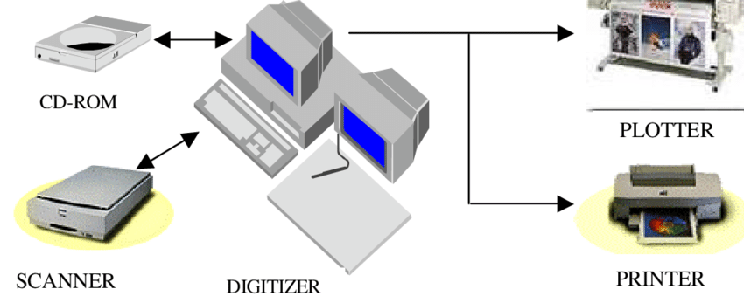
Component – Hardware
GIS hardware includes the computer systems that run GIS software, plus input/output devices
Desktops/workstations, GPS receivers, printers, large screens.

Slide 16
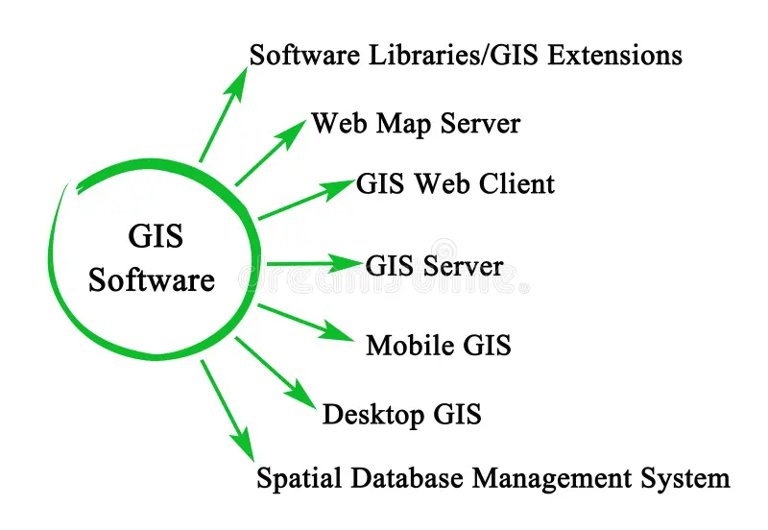
Component – Software
Software: provides the functions and tools needed to store, analyze, and display geographic information
It includes database management, analysis tools (e.g. spatial queries, geoprocessing), and mapping interfaces.
Several GIS software are available
Free and Open source: QGIS, ILWIS, GRASS GIS, SAGA GIS, MapWindow, etc.
Proprietary software: ArcGIS (ESRI ), GeoMedia, MapInfo, SuperGIS, IDRISI, etc..

Slide 17
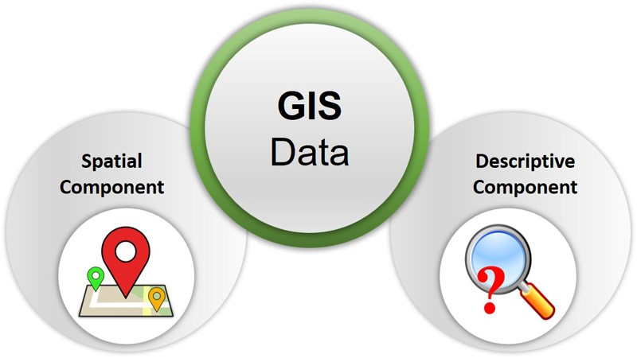
Component – Data
Spatial data: Geographic locations (points, lines, polygons, satellite images).
Attribute data: Tables that describe those spatial features (names, populations, etc).
Data is often called the heart of GIS

Slide 18
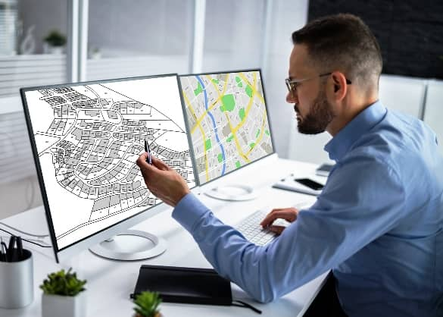
Component – People
People operate and manage the GIS throughout its life cycle
Roles: GIS managers, analysts, technicians, data collectors, end-users
Without skilled people, even powerful hardware/software/data have limited value

Slide 19
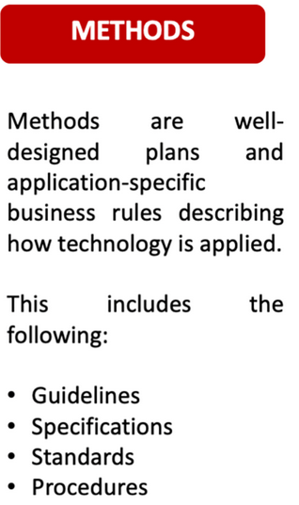
Component – Methods
Methods are the workflow rules, procedures, and models used with GIS
Includes how data is collected, processed, and analyzed (best practices).
Methods vary by project: e.g.
how often to update maps, or
the steps to perform an analysis.

Slide 20
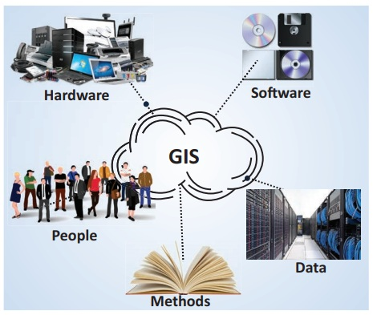
Summary of GIS Components
Hardware – the computers and devices (e.g. GPS) that run GIS.
Software – GIS applications for mapping and analysis.
Data – spatial and attribute data fed into the GIS.
People – users and analysts operating the GIS.
Methods – workflows and rules for how GIS is applied.

Slide 21
GIS Functional Subsystems – Overview
A complete GIS has four functional subsystems
Data Input
collecting/entering data
Data Storage/Retrieval
organizing and storing data
Data Analysis Manipulation
processing and modeling data
Data Output
displaying results as maps/reports

Slide 22
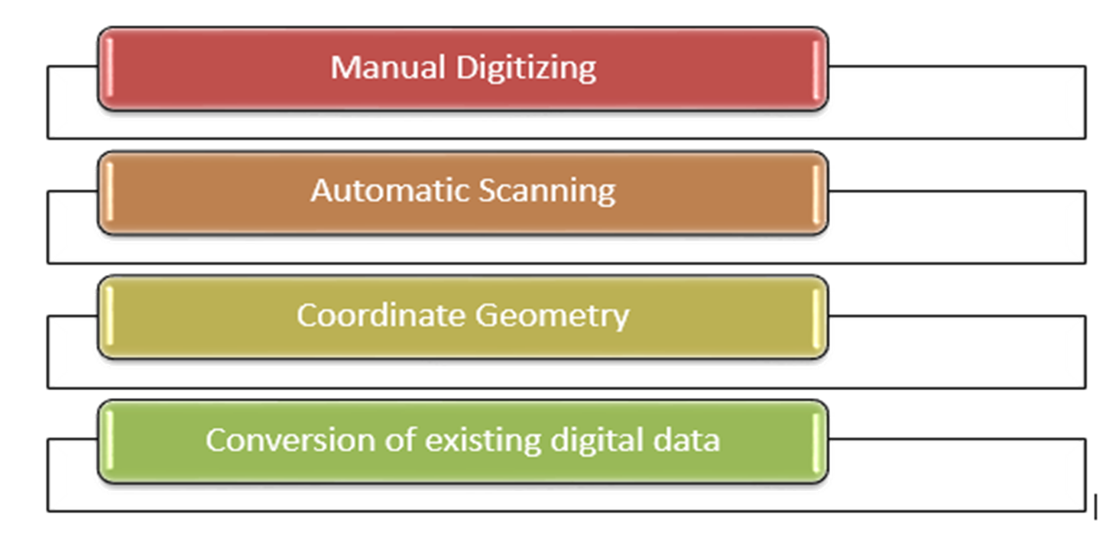
Subsystem – Data Input
tools for collecting and entering spatial data into the system

Slide 23
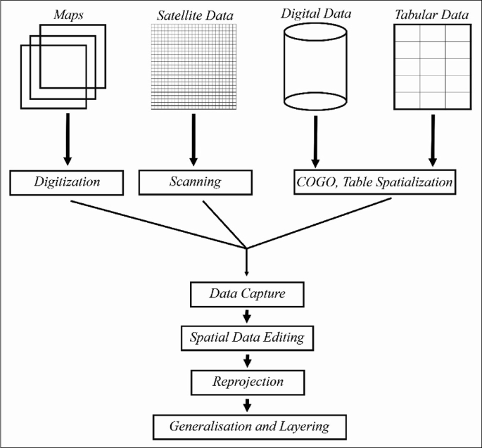
Data Input – Examples
Scanning old paper maps, then georeferencing them.
Using GPS devices/smartphones to collect coordinates of features
Data Input
Importing satellite imagery into the GIS.

Slide 24
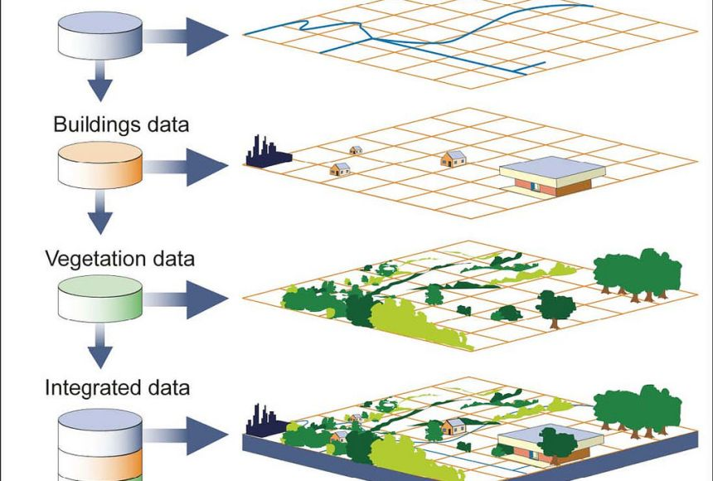
Subsystem – Data Storage/Retrieval
Storage: organizes spatial and attribute data in a database or file system
Ensures quick retrieval, updating, and editing of data.

Slide 25
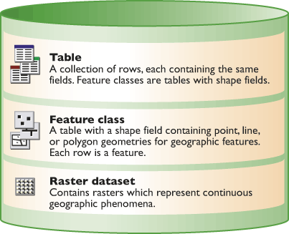
Storage – Key Points
Data is structured (layers, tables) so GIS can quickly retrieve needed information.
It supports editing (updating road networks, etc.) while preserving history.

Slide 26
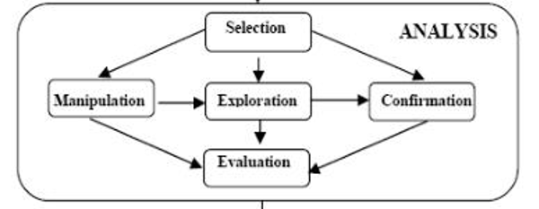
Subsystem – Analysis/Manipulation
Analysis: transforms data to answer spatial questions
Examples: overlaying flood zones with population data, 3D terrain analysis, route optimization.

Slide 27
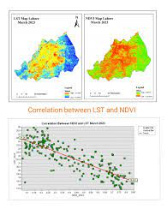
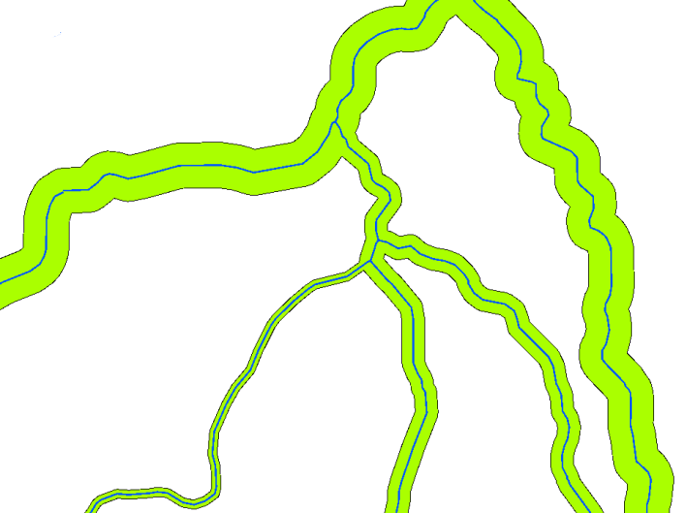
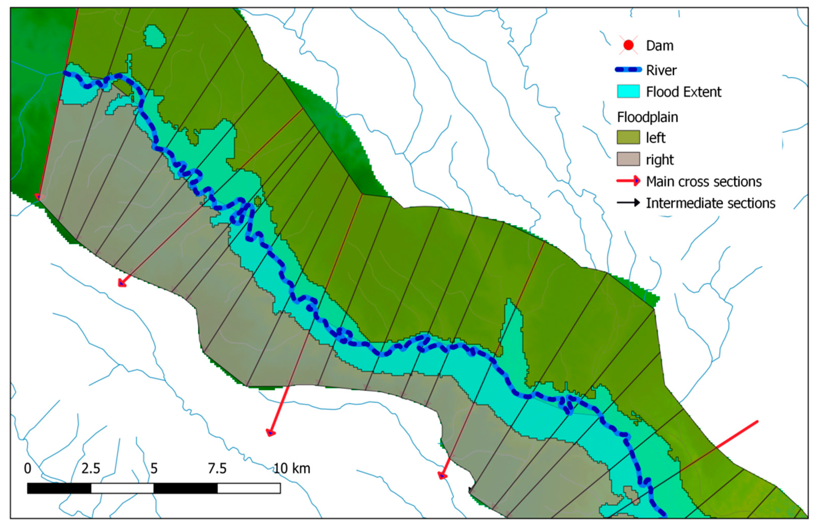
Analysis – Examples
Spatial analysis: buffer zones
(e.g., all houses within 1 km of a river).
Modeling: simulating scenarios
(e.g., spread of a forest fire).
Statistics: finding trends
(e.g., crime density per ward).

Slide 28
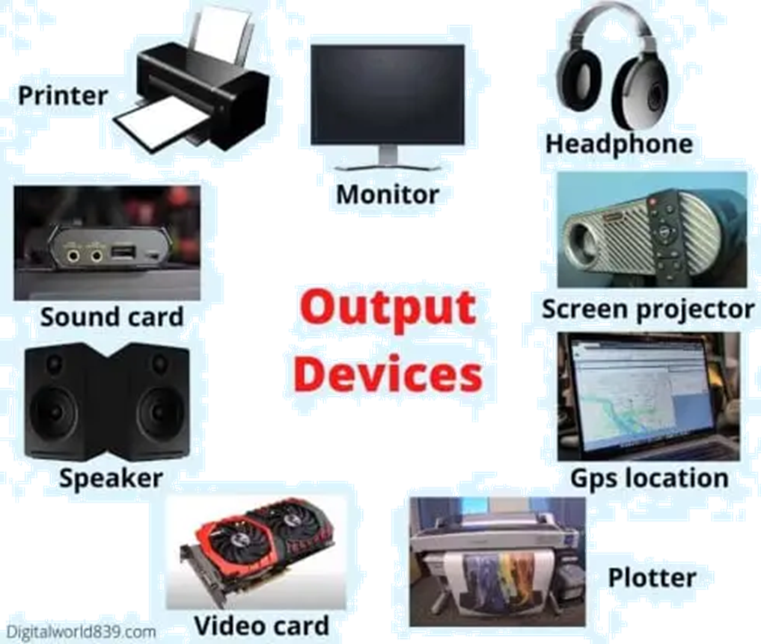
Subsystem – Output
Output: presents analysis results in map form or reports.
Generates thematic maps, charts, printed maps, or interactive web maps.

Slide 29
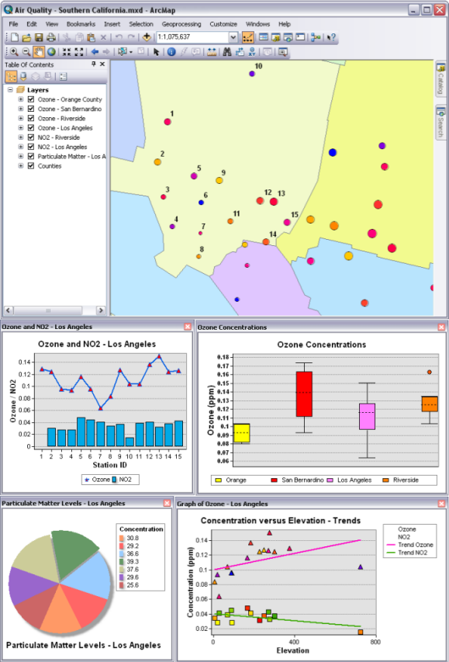
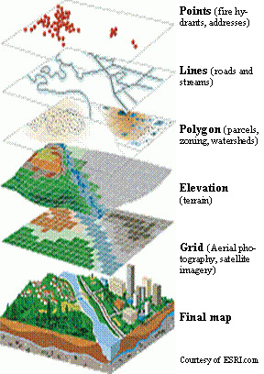
Output – Examples
Print or digital maps (e.g., emergency evacuation map).
Tables and graphs derived from spatial data (e.g., population by region).
Interactive maps (e.g., online GIS portal).

Slide 30
Review Questions
Q1: What does GIS stand for? List its five essential components.
Q2: Give two examples of how GIS is used in everyday life in Nepal.
Q3: Name the four functional subsystems of a GIS. What does each one do?
Q4: How can GIS be used in disaster management? Give an example
Q5: Describe a spatial thinking scenario you encounter in daily life. How does GIS relate to

Slide 31
Contact Information
Madhu Sudan Adhikari
msa2734@gmail.com
WhatsApp no. 9851260556

Slide 32
Thank You

